Slide 2
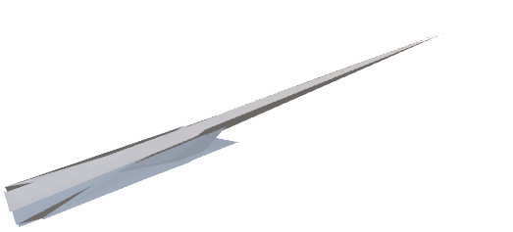
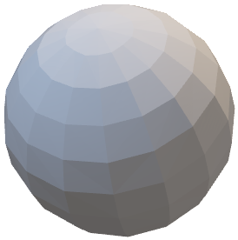
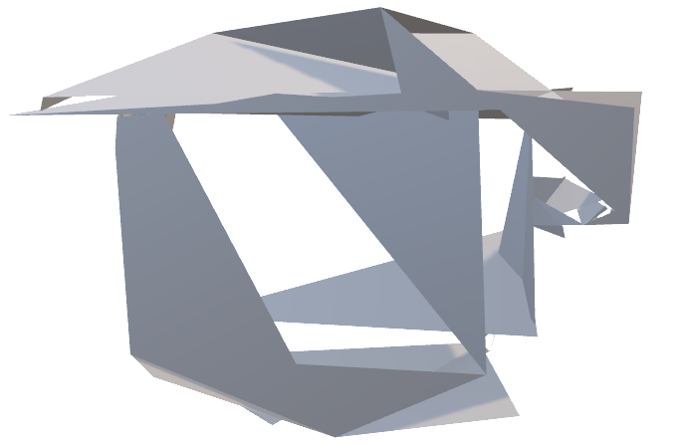
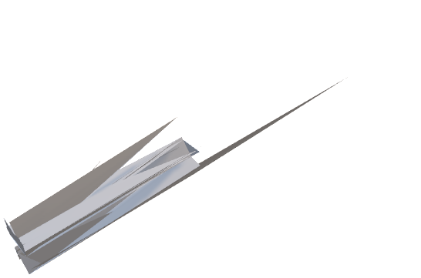
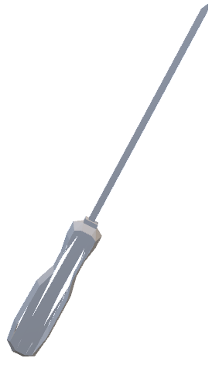
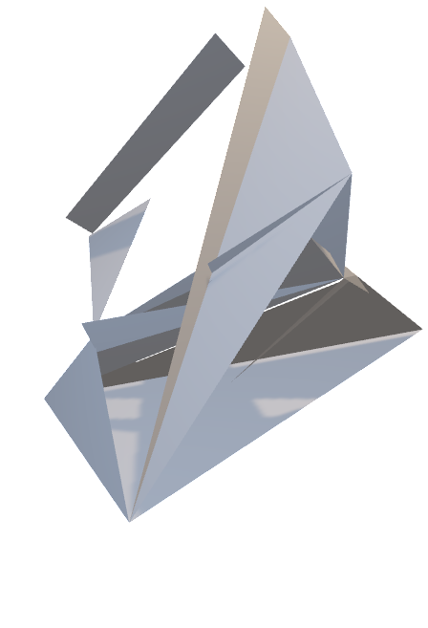
Part collection v3
Part collection v2
Part collection v1

Slide 3
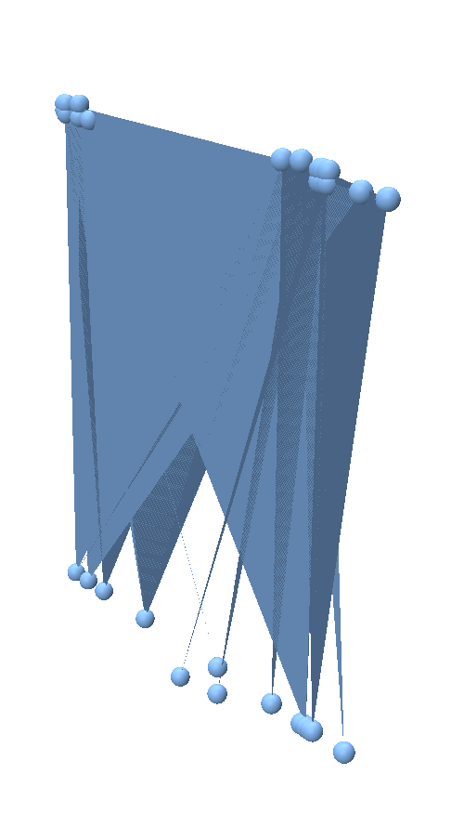
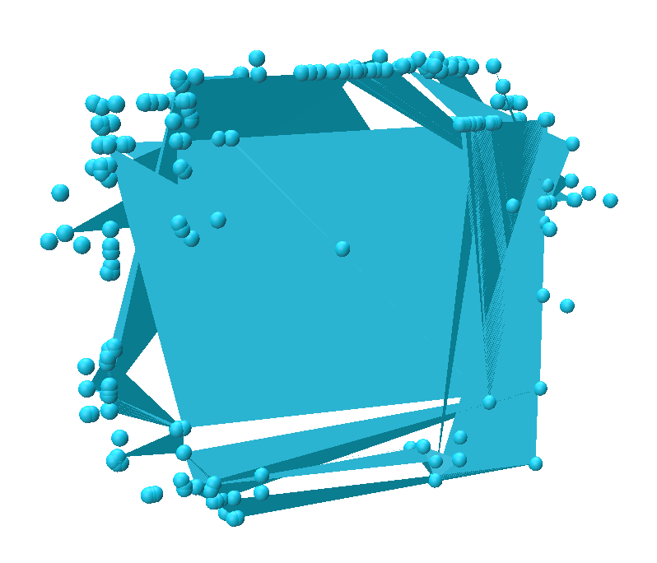
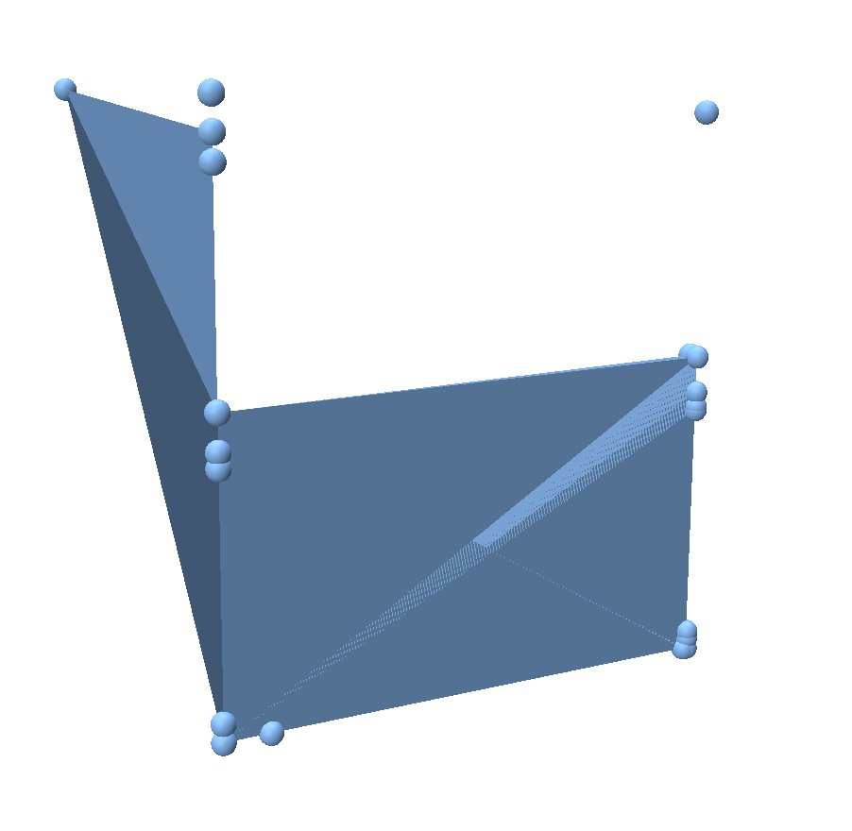
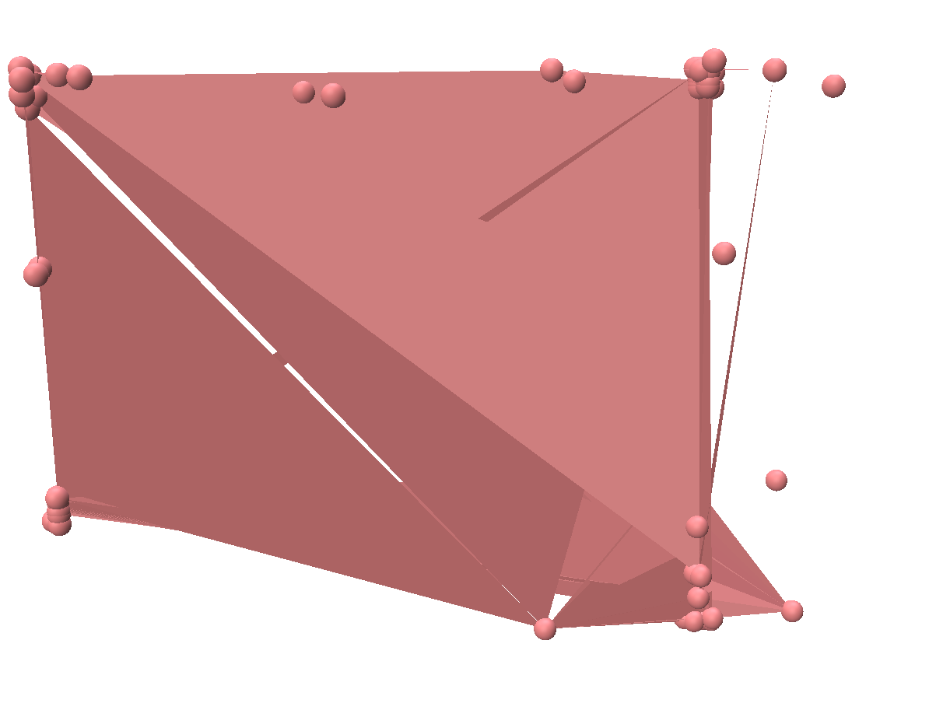
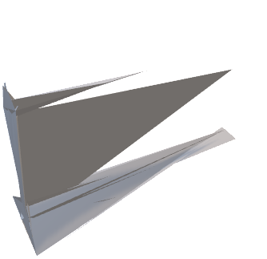

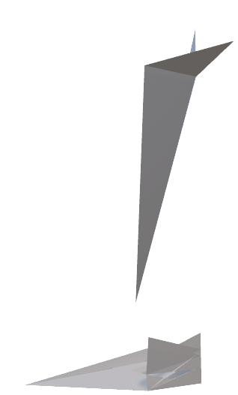
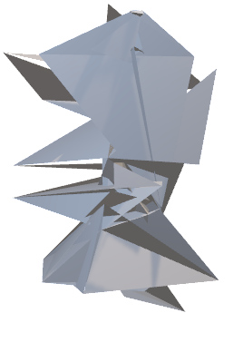

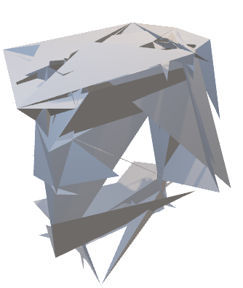
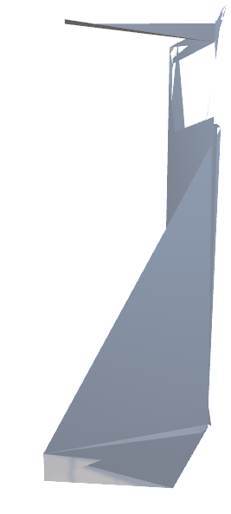
Part collection v2
All Parts

Slide 4
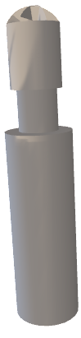
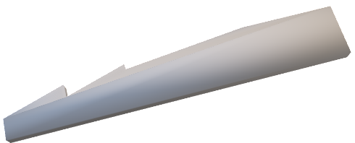
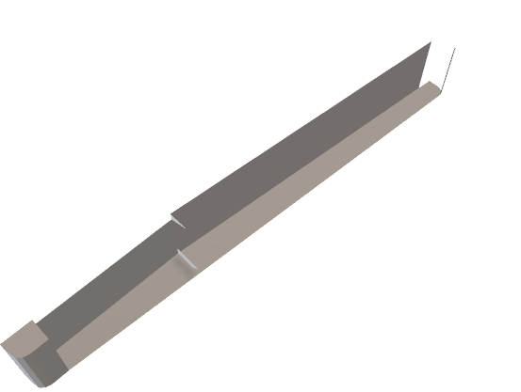

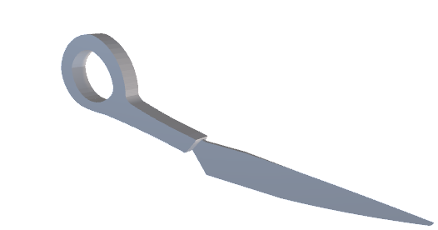


Part collection v3

Slide 5
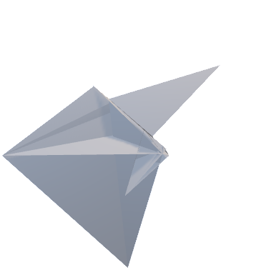
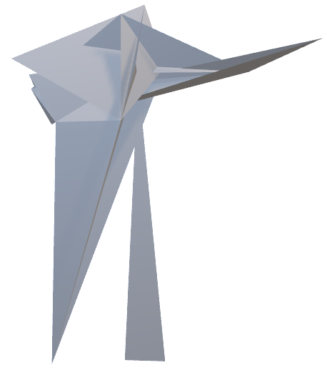
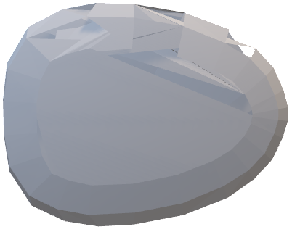
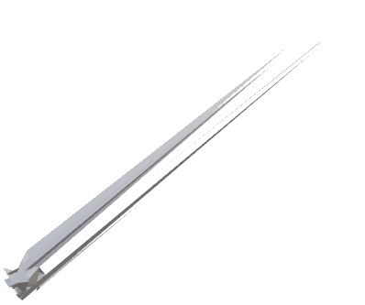




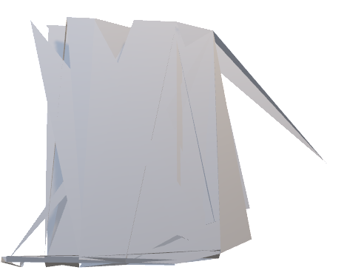

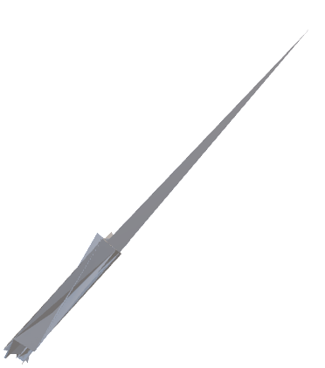
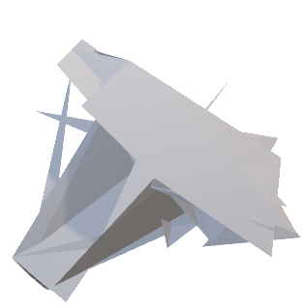
Parts orientation
Geometric appearance discrepancy
Part collection v3 + class conditional
Part collection v3 + class unconditional

Slide 6

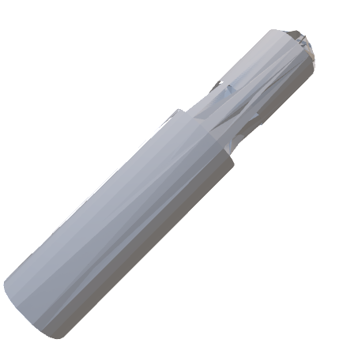
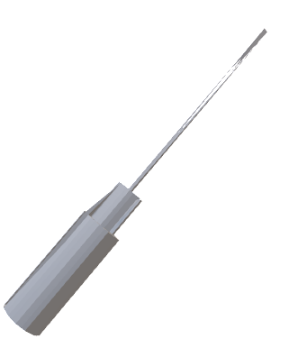
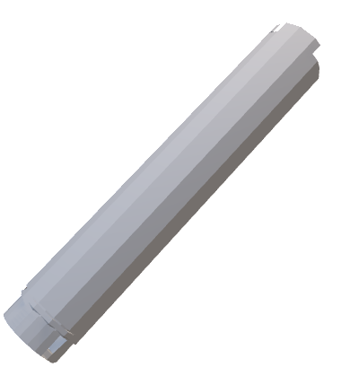



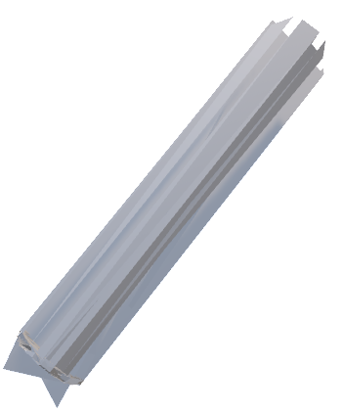

Part collection v4 + class conditional + larger model
Class idx 1
Class idx 2
Class idx 3
Class idx 4

Slide 7
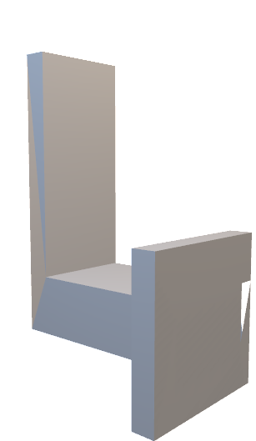
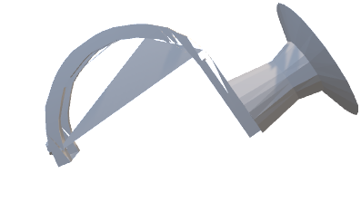
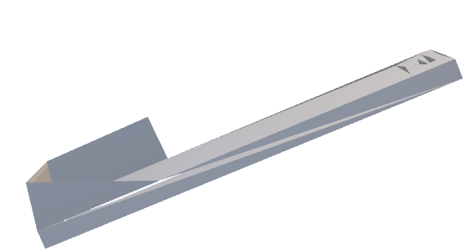
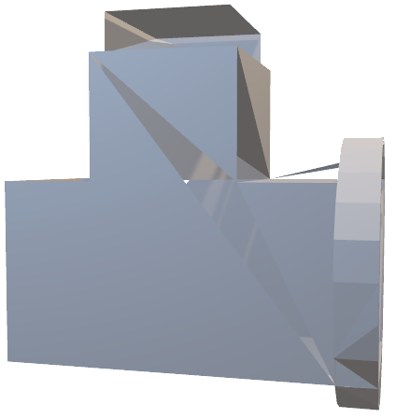
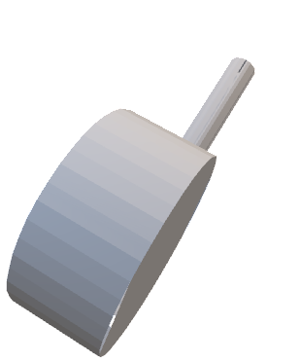
Part collection v1 + class unconditional + larger model

Slide 8
Pre-trained model + fine-tuning
Fine-tuning strategies: 1) full finetuning; 2) adapter finetuning; 3) prefix finetuning (all of them are ``parameter-efficient finetuning’’ approaches with some cross-domain generalization benefit that can be observed compared with full finetuning.)
Fine-tune a class conditional pre-trained model?
(…?)
Feature conditional pre-training and fine-tuning
Guided auto-regressive
Coarse-to-fine with vertex and face latent representations
Point Could guided semantic features
Or a pre-trained auto-encoder…

Slide 9
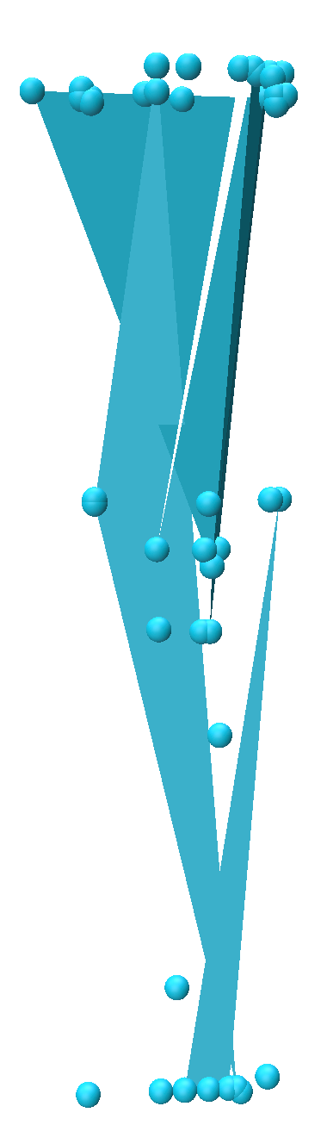
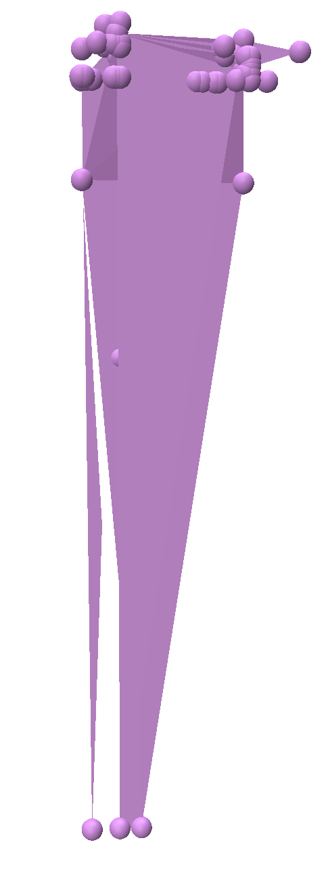
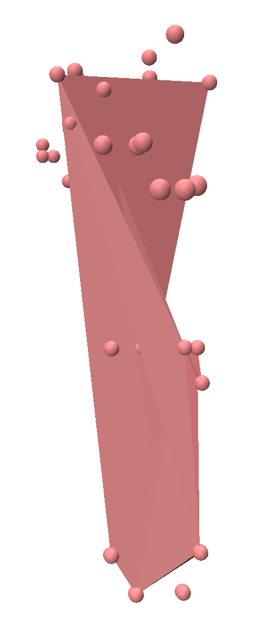
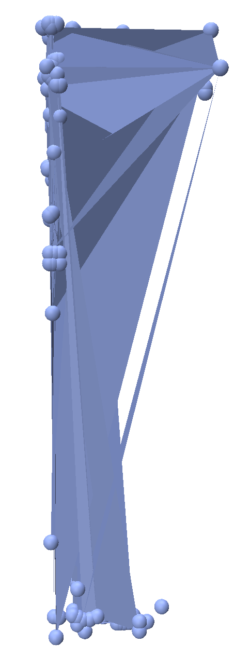
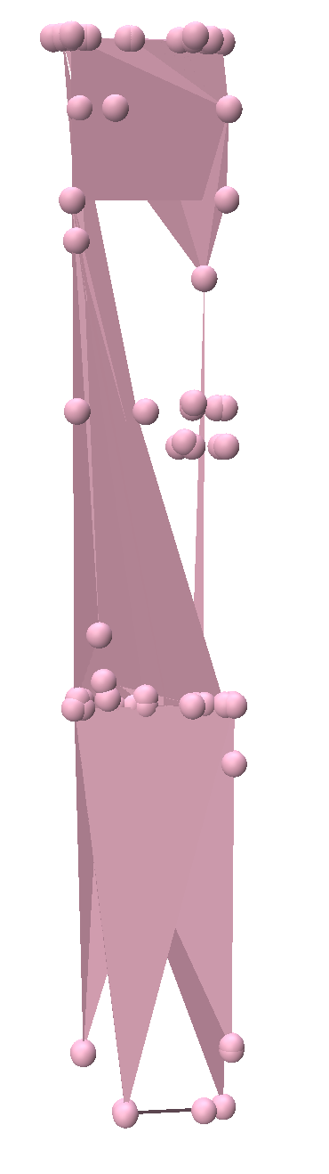
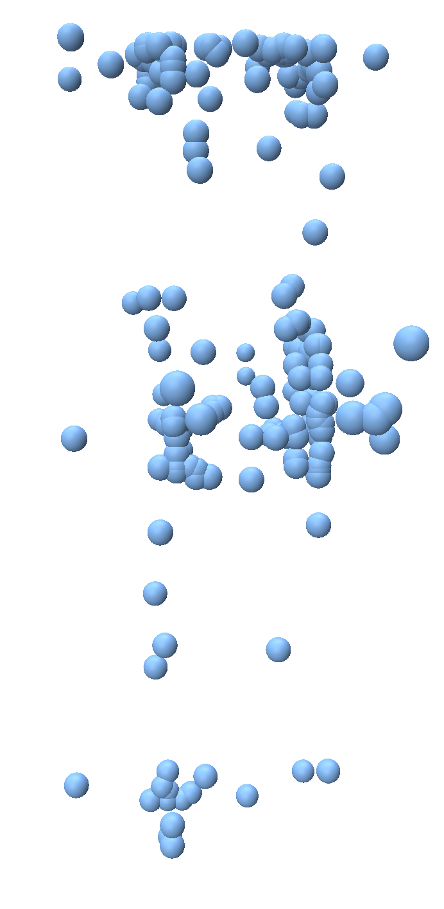
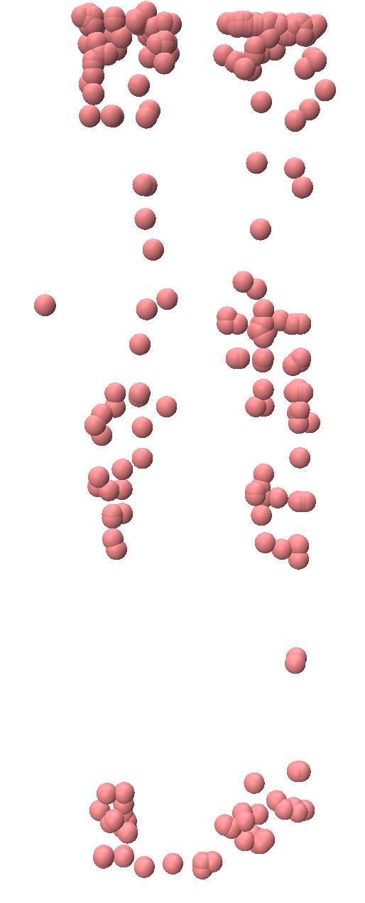
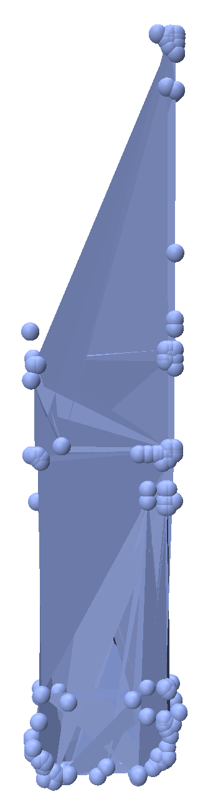
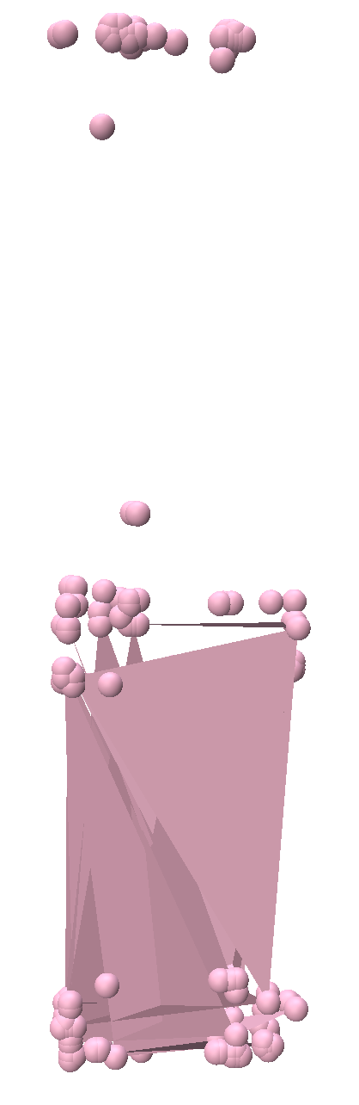
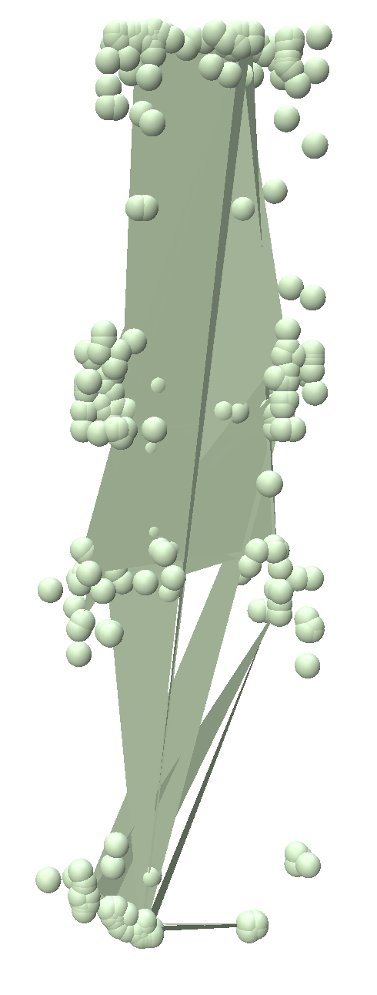
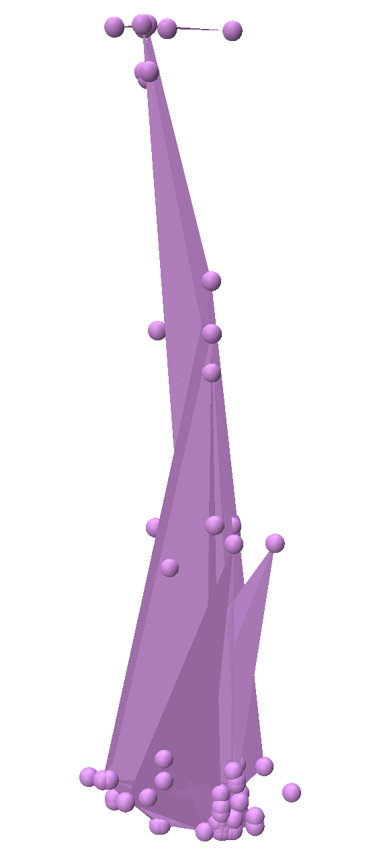
Part collection v3 + class unconditional + finetuning (step 200)

Slide 10
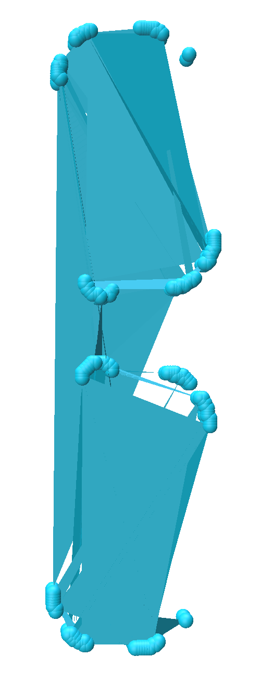
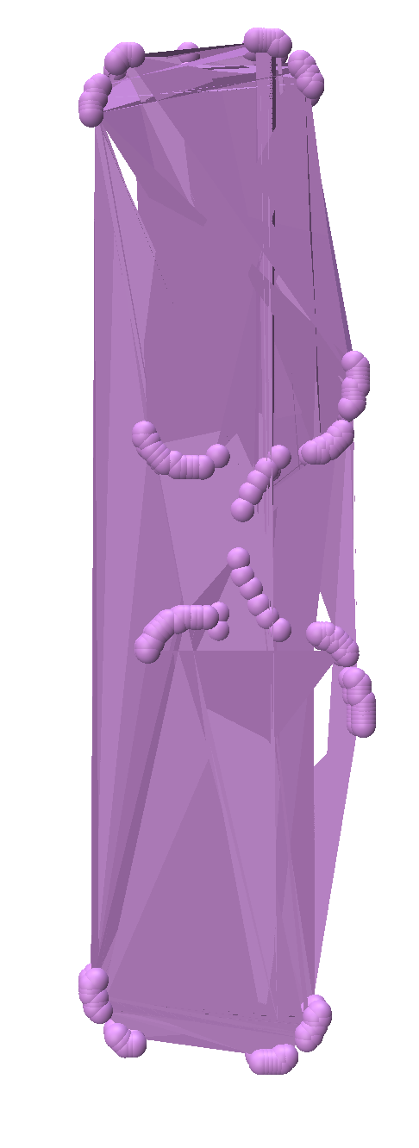
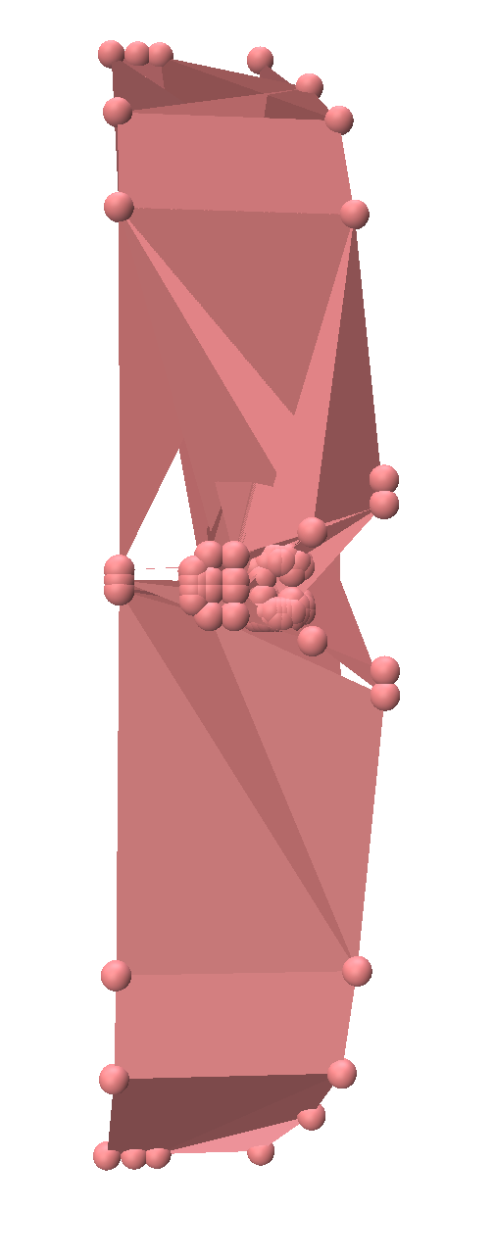
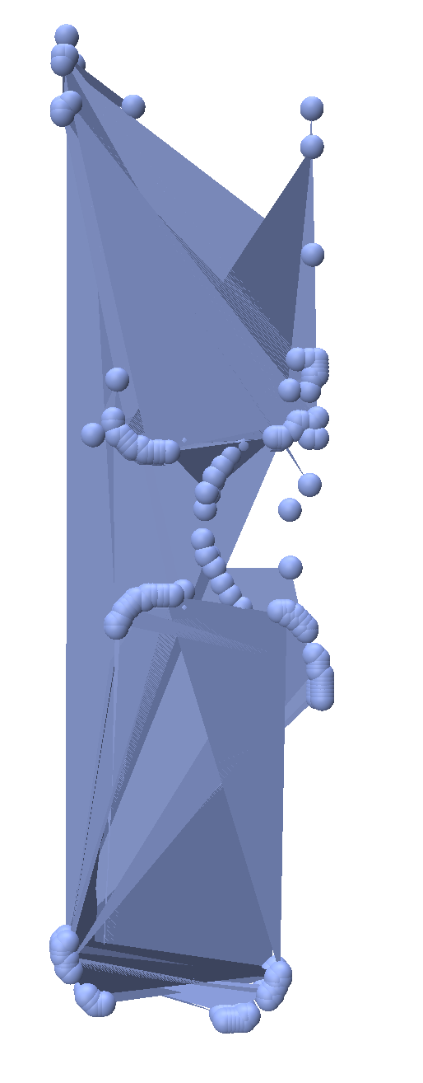








Part collection v3 + class unconditional + finetuning (step 600)
Part collection v3 + class unconditional + finetuning (step 1200)

Slide 11














Part collection v3 + class unconditional + adapter finetuning

Slide 12






Part collection v3 + class unconditional + prefix finetuning

Slide 13




Part collection v3 + class unconditional + finetuning (step 2000)

Slide 14



Coarse-to-fine autoregressive
Legs to Frames
Legs to Frames
Legs to Legs

Slide 15






Coarse-to-fine autoregressive (multiple parts to frames)
S1;
S2 | S1

Slide 16






Point Cloud conditional (part collection v1) + fine-tuning (only tune the pointnet module)

Slide 17








Two parts generation
Only Eyeglasses Legs
Multi-part collection v3

Slide 18
















Sample from the mode directly (one shot)
``Style’’, size, points density
points density

Slide 19






Unconditional pre-training

Slide 20



Slide 21




Unconditional pre-training (part collection v0)
Unconditional
Conditional (Screwdriver)

Slide 22


Unconditional pre-training + scaling

Slide 23









The unconditional pretrained model + full fine-tuning
Avg dist: 0.00214

Slide 24








The unconditional pretrained model + adapter fine-tuning
Avg dist: 0.00214

Slide 25









The unconditional pretrained model + prefix fine-tuning
The unconditional pretrained model + prompt finetuning
Prefix finetuning + oven

Slide 26































Conditional pretrained model + prompt finetuning
Conditional pretrained model + prompt finetuning
Closet Training data
Sample
(oven)
(water bottle)
Sample
Closest training shape
Training data
Sample
(oven)

Slide 27







The unconditional pretrained model + prefix fine-tuning (longer prefix)

Slide 28










Top samples from the trained model
Whole object and top samples

Slide 29








Train from scratch
0.0031168650165921043
train_idx_to_nns: {22: 7, 15: 13, 14: 4, 35: 15, 30: 12, 23: 7, 21: 9, 33: 15, 27: 7, 3: 7, 17: 2, 4: 4, 41: 10, 28: 13, 24: 5, 16: 13, 26: 8, 9: 5, 18: 1, 6: 3}
20, entropy = 2.845
0.0021380915614255354
{3: 8, 21: 7, 16: 8, 6: 5, 41: 7, 28: 10, 23: 8, 35: 26, 15: 8, 33: 4, 22: 7, 30: 6, 4: 5, 14: 9, 26: 5, 27: 4, 9: 5, 24: 4}
18, entriopy = 2.747
0.1177947
{3: 8, 21: 7, 16: 8, 6: 5, 41: 7, 28: 10, 23: 8, 35: 26, 15: 8, 33: 4, 22: 7, 30: 6, 4: 5, 14: 9, 26: 5, 27: 4, 9: 5, 24: 4}
18, entriopy = 2.8446

Slide 30











The unconditional pretrained model + full fine-tuning + random scaling
Train from scratch + random scaling
Missing faces due to mesh simplification…

Slide 31




Prompt finetuning, Avg dist: 0.002953

Slide 32









Coarse-to-fine (Conditional Generation) --- Zero-shot
Coarse-to-fine (Conditional Generation) --- Full Fine-tune

Slide 33





Coarse-to-fine (Conditional Generation) --- Prompt Fine-tune
Closet training shape

Slide 34




Coarse pre-training 0.2 faces

Slide 36











Pre-training --- window context
WS = 405
WS = 750

Slide 37




Pre-training --- window context (only for eyeglasses frames)

Slide 38
Is finetuning a correct way to transfer knowledge from training parts to test parts?
Optimize training data distribution (the down-stream task)
v.s.
Learn an smooth eyeglasses shape manifold from limited eyeglasses samples

Slide 39
Water bottle
Frames
Oven
Water bottle
Frames

Slide 40





Language Modeling (from cs231n)
Inference Time (Sample from the trained distribution)
Training Time
Not a ``big model’’, an RNN can perform well
Not ``down-stream tasks’’, just inference from the trained distribution

Slide 41



Language Modeling (from cs231n)
Input (Conditions)
Generated Samples
A conditional generation (not a down stream task); “in response to the model being primed with an arbitrary input. The model is chameleon-like—it adapts to the style and content of the conditioning text.”

Slide 42



Prompt, prompt tuning for few-shot learning
Prompt discriminative models for better few-shot learning (but not for generative down-stream tasks, e.g. multiple choices, sentiment classification)
Single token
Multiple tokens
Autoregressive generation
Prefix to steer the pretrained model for each downstream task. ``Continuous vectors can be used to steer language models’’
Prompt tuning
Prefix tuning
Adapter tuning
---- to save parameters
---- perform no better than full finetuning
PET (Pattern Exploiting Training) for using MLMs to perform discriminative down stream tasks

Slide 43
Prompt, prompt tuning for few-shot learning
Neural Language Generation task, such as reading comprehension, summarization, or some text-to-text tasks -- they have ``correct’’ answers, and the goal is not free generation/encode distributions of the training data/transfer the distribution from a large collection to a specific category
A pretrained LSTM LM can reconstruct arbitrary sentences by optimizing a continuous vector for each sentence, making the vector ``input-specific’’ (but not for learning a distribution space for sentences of a specific kind) ---- prefix-tuning then optimizes a ``task-specific’’ vector for an NLG task. ``Controllable generation aims to steer a pretrained model to match a sequence level attribute’’
Prefix to steer the pretrained model for each downstream task. ``Continuous vectors can be used to steer language models’’
The assumption is that knowledge can be prompted from the pre-trained model (with Interpretability w.r.t. what are represented in those words.)

Slide 44
Prompt, prompt tuning for few-shot learning
A powerful pre-trained model
Model size
Pre-training strategy?
(Assumption for the pre-trained model --- with general knowledge of object mesh structure)
Fine-tuning / prompting strategies
Fine-tuning --- prompt knowledge from the model (with weight update)
Prompting --- prompt knowledge from the model (without weight update)
Data
Mesh structure…

Slide 45
Compared with language models
Words embeddings v.s. vertex coordinate embeddings
1) Word semantic meanings; 2) Contextual information
Sentence embeddings v.s. sub structure embeddings
For meshes: Might vary across categories
1) Semantic meanings; 2) Contextual information
Cross lingual models
Cross-lingual words embeddings

Slide 46
















Context window = 750

Slide 47
















Context window = 750

Slide 48








Context window = 750

Slide 49



Context window = 750 + prompt fine tune on frames

Slide 50




Context window = 750
Context window = 750

Slide 51





Cut vertices

Slide 52




Scaling, full window
Warping

Slide 53





Data

Slide 54




Context window = 750, conditional
Context window = 750, unconditional

Slide 55










Masked modeling

Slide 56




Big model

Slide 57


Big model
半个月到一个月…

